Slide 1
Cryptography and Network Security
MAC
HMAC
CMAC

Slide 2
Session Meta Data
Author | Dr T Sree Sharmila
Reviewer
Version Number | 1.0
Release Date | 19 July 2018

Slide 3
Revision History
Revision Date | Details | Version no.
 |  | 1.0

Slide 4
Agenda
Introduction
Message authentication requirements
Message authentication using encryption
MACs
HMAC authentication using a hash function
CMAC authentication using a block cipher
Summary
Test your understanding
References

Slide 5
Introduction
message authentication is concerned with:
protecting the integrity of a message
validating identity of originator
non-repudiation of origin (dispute resolution)
will consider the security requirements
then three alternative functions used:
hash function
message encryption
message authentication code (MAC)
Notes:
5
One of the most fascinating and complex areas of cryptography is that of message authentication and the related area of digital signatures. We now consider how to protect message integrity (ie protection from modification), as well as confirming the identity of the sender. Generically this is the problem of message authentication, and in eCommerce applications is arguably more important than secrecy. Message Authentication is concerned with: protecting the integrity of a message, validating identity of originator, & non-repudiation of origin (dispute resolution). There are three types of functions that may be used to produce an authenticator: a hash function, message encryption, message authentication code (MAC). Hash functions, and how they may serve for message authentication, are discussed in Chapter 11. The remainder of this section briefly examines the remaining two topics. The remainder of the chapter elaborates on the topic of MACs.

Slide 6
Agenda
Introduction
Message authentication requirements
Message authentication using encryption
MACs
HMAC authentication using a hash function
CMAC authentication using a block cipher
Summary
Test your understanding
References

Slide 7
Message Security Requirements
disclosure
traffic analysis
masquerade
content modification
sequence modification
timing modification
source repudiation
destination repudiation
Notes:
7
In the context of communications across a network, the attacks listed above can be identified, with more detail given in the text. The first two requirements (Disclosure: Release of message contents; and Traffic analysis: Discovery of the pattern of traffic between parties) belong in the realm of message confidentiality, and are handled using the encryption techniques already discussed. Measures to deal with items 3 through 6 (Masquerade: Insertion of messages into the network from a fraudulent source; Content modification: of the contents of a message; Sequence modification: to a sequence of messages between parties; and Timing modification: Delay or replay of messages) are generally regarded as message authentication. Mechanisms for dealing specifically with item 7 (Source repudiation: Denial of transmission of message by source) come under the heading of digital signatures. Generally, a digital signature technique will also counter some or all of the attacks listed under items 3 through 6. Dealing with item 8 (Destination repudiation: Denial of receipt of message by destination) may require a combination of the use of digital signatures and a protocol designed to counter this attack.
In summary, message authentication is a procedure to verify that received messages come from the alleged source and have not been altered. Message authentication may also verify sequencing and timeliness. A digital signature is an authentication technique that also includes measures to counter repudiation by the source.

Slide 8
Agenda
Introduction
Message authentication requirements
Message authentication using encryption
MACs
HMAC authentication using a hash function
CMAC authentication using a block cipher
Summary
Test your understanding
References

Slide 9
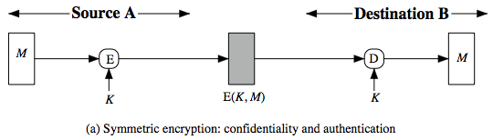
Symmetric Message Encryption
encryption can also provides authentication
if symmetric encryption is used then:
receiver know sender must have created it
since only sender and receiver know key used
know content cannot have been altered...
... if message has suitable structure, redundancy or a suitable checksum to detect any changes
Notes:
9
Message encryption by itself can provide a measure of authentication. The analysis differs for symmetric and public-key encryption schemes.
If use symmetric encryption, If no other party knows the key, then confidentiality is provided. As well, symmetric encryption provides authentication as well as confidentiality, since only the other party can have encrypted a properly constructed message (Stallings Figure 12.1a). Here, the ciphertext of the entire message serves as its authenticator, on the basis that only those who know the appropriate keys could have validly encrypted the message. This is provided you can recognize a valid message (ie if the message has suitable structure such as redundancy or a checksum to detect any changes).

Slide 10
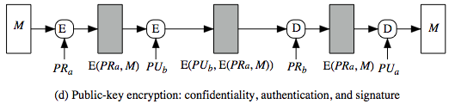
Public-Key Message Encryption
if public-key encryption is used:
encryption provides no confidence of sender
since anyone potentially knows public-key
however if
sender signs message using their private-key
then encrypts with recipients public key
have both secrecy and authentication
again need to recognize corrupted messages
but at cost of two public-key uses on message
Notes:
10
With public-key techniques, can use a digital signature which can only have been created by key owner to validate the integrity of the message contents. To provide both confidentiality and authentication, A can encrypt M first using its private key, which provides the digital signature, and then using B's public key, which provides confidentiality (Stallings Figure 12.1d). The disadvantage of this approach is that the public-key algorithm, which is complex, must be exercised four times rather than two in each communication.

Slide 11
Public-Key Message Encryption
Dirty little detail on PKCS
Every time you encrypt, size expands
Due to protections in PKCS#1
So signing (by encryption) then encrypting, the size is more than doubled!
Notes:
11
With public-key techniques, can use a digital signature which can only have been created by key owner to validate the integrity of the message contents. To provide both confidentiality and authentication, A can encrypt M first using its private key, which provides the digital signature, and then using B's public key, which provides confidentiality (Stallings Figure 12.1d). The disadvantage of this approach is that the public-key algorithm, which is complex, must be exercised four times rather than two in each communication.

Slide 12
Agenda
Introduction
Message authentication requirements
Message authentication using encryption
MACs
HMAC authentication using a hash function
CMAC authentication using a block cipher
Summary
Test your understanding
References

Slide 13
Message Authentication Code (MAC)
generated by an algorithm that creates a small fixed-sized block
depending on both message and secret key
like encryption though need not be reversible
appended to message as a “signature”
receiver performs same computation on message and checks it matches the MAC
provides assurance that message is unaltered and comes from sender
Notes:
13
An alternative authentication technique involves the use of a secret key to generate a small fixed-size block of data, known as a cryptographic checksum or MAC that is appended to the message. This technique assumes that two communicating parties, say A and B, share a common secret key K. A MAC function is similar to encryption, except that the MAC algorithm need not be reversible, as it must for decryption.

Slide 14
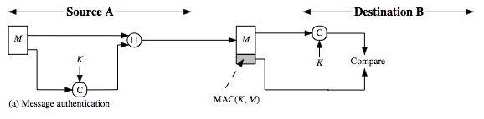
Message Authentication Code
a small fixed-sized block of data
generated from message + secret key
MAC = C(K,M)
appended to message when sent
Notes:
14
An alternative authentication technique involves the use of a secret key to generate a small fixed- size block of data, known as a cryptographic checksum or MAC that is appended to the message. This technique assumes that two communicating parties, say A and B, share a common secret key K. When A has a message to send to B, it calculates the MAC as a function of the message and the key: MAC = C(K, M). The message plus MAC are transmitted to the intended recipient. The recipient performs the same calculation on the received message, using the same secret key, to generate a new MAC. The received MAC is compared to the calculated MAC (Stallings Figure 12.4a). If we assume that only the receiver and the sender know the identity of the secret key, and if the received MAC matches the calculated MAC, then the receiver is assured that the message has not been altered, is from the alleged sender, and if the message includes a sequence number then the receiver can be assured of the proper sequence because an attacker cannot successfully alter the sequence number. A MAC function is similar to encryption. One difference is that the MAC algorithm need not be reversible, as it must for decryption. In general, the MAC function is a many-to-one function.

Slide 15
Message Authentication Code
An alternative authentication technique involves the use of a secret key to generate a small fixed- size block of data, known as a cryptographic checksum or MAC that is appended to the message.
This technique assumes that two communicating parties, say A and B, share a common secret key K.
When A has a message to send to B, it calculates the MAC as a function of the message and the key: MAC = C(K, M).
The message plus MAC are transmitted to the intended recipient.
The recipient performs the same calculation on the received message, using the same secret key, to generate a new MAC.
Notes:
15
An alternative authentication technique involves the use of a secret key to generate a small fixed- size block of data, known as a cryptographic checksum or MAC that is appended to the message. This technique assumes that two communicating parties, say A and B, share a common secret key K. When A has a message to send to B, it calculates the MAC as a function of the message and the key: MAC = C(K, M). The message plus MAC are transmitted to the intended recipient. The recipient performs the same calculation on the received message, using the same secret key, to generate a new MAC. The received MAC is compared to the calculated MAC (Stallings Figure 12.4a). If we assume that only the receiver and the sender know the identity of the secret key, and if the received MAC matches the calculated MAC, then the receiver is assured that the message has not been altered, is from the alleged sender, and if the message includes a sequence number then the receiver can be assured of the proper sequence because an attacker cannot successfully alter the sequence number. A MAC function is similar to encryption. One difference is that the MAC algorithm need not be reversible, as it must for decryption. In general, the MAC function is a many-to-one function.

Slide 16
Message Authentication Code
The received MAC is compared to the calculated MAC.
If we assume that only the receiver and the sender know the identity of the secret key, and if the received MAC matches the calculated MAC,
then the receiver is assured that the message has not been altered, is from the alleged sender, and if the message includes a sequence number then the receiver can be assured of the proper sequence because an attacker cannot successfully alter the sequence number.
A MAC function is similar to encryption.
One difference is that the MAC algorithm need not be reversible, as it must for decryption.
In general, the MAC function is a many-to-one function.
Notes:
16
An alternative authentication technique involves the use of a secret key to generate a small fixed- size block of data, known as a cryptographic checksum or MAC that is appended to the message. This technique assumes that two communicating parties, say A and B, share a common secret key K. When A has a message to send to B, it calculates the MAC as a function of the message and the key: MAC = C(K, M). The message plus MAC are transmitted to the intended recipient. The recipient performs the same calculation on the received message, using the same secret key, to generate a new MAC. The received MAC is compared to the calculated MAC (Stallings Figure 12.4a). If we assume that only the receiver and the sender know the identity of the secret key, and if the received MAC matches the calculated MAC, then the receiver is assured that the message has not been altered, is from the alleged sender, and if the message includes a sequence number then the receiver can be assured of the proper sequence because an attacker cannot successfully alter the sequence number. A MAC function is similar to encryption. One difference is that the MAC algorithm need not be reversible, as it must for decryption. In general, the MAC function is a many-to-one function.

Slide 17
Message Authentication Codes
as shown the MAC provides authentication
can also use encryption for secrecy
generally use separate keys for each
can compute MAC either before or after encryption
is generally regarded as better done before, but see Generic Composition
Notes:
17
The process depicted on the previous slide provides authentication but not confidentiality, because the message as a whole is transmitted in the clear. Confidentiality can be provided by performing message encryption either after (see Stallings Figure 12.4b) or before (see Stallings Figure 12.4c) the MAC algorithm. In both these cases, two separate keys are needed, each of which is shared by the sender and the receiver. Typically, it is preferable to tie the authentication directly to the plaintext, so the method of Figure 12.4b is used. Can use MAC in circumstances where just authentication is needed (or needs to be kept), see text for examples (e.g. such as when the same message is broadcast to a number of destinations; when one side has a heavy load and cannot afford the time to decrypt all incoming messages; or do not need to keep messages secret, but must authenticate messages). Finally, note that the MAC does not provide a digital signature because both sender and receiver share the same key.

Slide 18
Message Authentication Codes
why use a MAC?
sometimes only authentication is needed
sometimes need authentication to persist longer than the encryption (e.g. archival use)
note that a MAC is not a digital signature
Does NOT provide non-repudiation
Notes:
18
The process depicted on the previous slide provides authentication but not confidentiality, because the message as a whole is transmitted in the clear. Confidentiality can be provided by performing message encryption either after (see Stallings Figure 12.4b) or before (see Stallings Figure 12.4c) the MAC algorithm. In both these cases, two separate keys are needed, each of which is shared by the sender and the receiver. Typically, it is preferable to tie the authentication directly to the plaintext, so the method of Figure 12.4b is used. Can use MAC in circumstances where just authentication is needed (or needs to be kept), see text for examples (e.g. such as when the same message is broadcast to a number of destinations; when one side has a heavy load and cannot afford the time to decrypt all incoming messages; or do not need to keep messages secret, but must authenticate messages). Finally, note that the MAC does not provide a digital signature because both sender and receiver share the same key.

Slide 19
MAC Properties
a MAC is a cryptographic checksum
MAC = C_{K}(M)
condenses a variable-length message M
using a secret key K
to a fixed-sized authenticator
is a many-to-one function
potentially many messages have same MAC
but finding these needs to be very difficult
Notes:
19
A MAC (also known as a cryptographic checksum, fixed-length authenticator, or tag) is generated by a function C. The MAC is appended to the message at the source at a time when the message is assumed or known to be correct. The receiver authenticates that message by re-computing the MAC.
The MAC function is a many-to-one function, since potentially many arbitrarily long messages can be condensed to the same summary value, but don’t want finding them to be easy (see text for discussion)!

Slide 20
Requirements for MACs
taking into account the types of attacks
need the MAC to satisfy the following:
knowing a message and MAC, is infeasible to find another message with same MAC
MACs should be uniformly distributed
MAC should depend equally on all bits of the message
Notes:
20
In assessing the security of a MAC function, we need to consider the types of attacks that may be mounted against it. Hence it needs to satisfy the listed requirements.
The first requirement deals with message replacement attacks, in which an opponent is able to construct a new message to match a given MAC, even though the opponent does not know and does not learn the key.
The second requirement deals with the need to thwart a brute-force attack based on chosen plaintext.
The final requirement dictates that the authentication algorithm should not be weaker with respect to certain parts or bits of the message than others.

Slide 21
Security of MACs
like block ciphers have:
brute-force attacks exploiting
strong collision resistance hash have cost 2^{m/2}
128-bit hash looks vulnerable, 160-bits better
MACs with known message-MAC pairs
can either attack keyspace (cf. key search) or MAC
at least 128-bit MAC is needed for security
Notes:
21
Just as with symmetric and public-key encryption, we can group attacks on hash functions and MACs into two categories: brute-force attacks and cryptanalysis.
A brute-force attack on a MAC is a more difficult undertaking than a brute-force attack on a hash function because it requires known message-tag pairs. The strength of a hash function against brute-force attacks depends solely on the length of the hash code produced by the algorithm, with cost O(2^m/2). A brute-force attack on a MAC has cost related to min(2^k, 2^n), similar to symmetric encryption algorithms. It would appear reasonable to require that the key length and MAC length satisfy a relationship such as min(k, n) >= N, where N is perhaps in the range of 128 bits.

Slide 22
Security of MACs
cryptanalytic attacks exploit structure
like block ciphers want brute-force attacks to be the best alternative
more variety of MACs so harder to generalize about cryptanalysis
Notes:
22
As with encryption algorithms, cryptanalytic attacks on hash functions and MAC algorithms seek to exploit some property of the algorithm to perform some attack other than an exhaustive search. The way to measure the resistance of a hash or MAC algorithm to cryptanalysis is to compare its strength to the effort required for a brute-force attack. That is, an ideal hash or MAC algorithm will require a cryptanalytic effort greater than or equal to the brute-force effort. There is much more variety in the structure of MACs than in hash functions, so it is difficult to generalize about the cryptanalysis of MACs. Further, far less work has been done on developing such attacks.

Slide 23
Keyed Hash Functions as MACs
want a MAC based on a hash function
because hash functions are generally faster
crypto hash function code is widely available
hash includes a key along with message
original proposal:
KeyedHash = Hash(Key|Message)
some weaknesses were found with this
eventually led to development of HMAC
Notes:
23
In recent years, there has been increased interest in developing a MAC derived from a cryptographic hash function, because they generally execute faster in software than symmetric block ciphers, and because code for cryptographic hash functions is widely available. A hash function such as SHA was not designed for use as a MAC and cannot be used directly for that purpose because it does not rely on a secret key. There have been a number of proposals for the incorporation of a secret key into an existing hash algorithm, originally by just pre-pending a key to the message. Problems were found with these earlier, simpler proposals, but they resulted in the development of HMAC.

Slide 24
Problem with Keyed Hash
KeyedHash = Hash(Key|Message)
Recall hash function works on blocks
Let M = Key | Message | Padding and M
M=M₁ M₂ … M_{L}, where |M_{i}| = Blocksize
Hash=H(H(…H(H(IV,M₁),M₂),…,M_{L})
But can add extra block(s) M_{L+1} by
Hash’=H(Hash,M_{L+1})
Unless formatting prevents it…
… but still best to use HMAC!
Notes:
24
In recent years, there has been increased interest in developing a MAC derived from a cryptographic hash function, because they generally execute faster in software than symmetric block ciphers, and because code for cryptographic hash functions is widely available. A hash function such as SHA was not designed for use as a MAC and cannot be used directly for that purpose because it does not rely on a secret key. There have been a number of proposals for the incorporation of a secret key into an existing hash algorithm, originally by just pre-pending a key to the message. Problems were found with these earlier, simpler proposals, but they resulted in the development of HMAC.

Slide 25
Agenda
Introduction
Message authentication requirements
Message authentication using encryption
MACs
HMAC authentication using a hash function
CMAC authentication using a block cipher
Summary
Test your understanding
References

Slide 26
HMAC Design Objectives
use, without modifications, hash functions
allow for easy replacement of embedded hash function
preserve original performance of hash function without significant degradation
use and handle keys in a simple way.
have well understood cryptographic analysis of authentication mechanism strength
Notes:
RFC 2104 lists the following design objectives for HMAC:
• To use, without modifications, available hash functions. In particular, hash functions that perform well in software, and for which code is freely and widely available.
• To allow for easy replaceability of the embedded hash function in case faster or more secure hash functions are found or required.
• To preserve the original performance of the hash function without incurring a significant degradation.
• To use and handle keys in a simple way.
• To have a well understood cryptographic analysis of the strength of the authentication mechanism based on reasonable assumptions about the embedded hash function.
26

Slide 27
HMAC
specified as Internet standard RFC2104
uses hash function on the message:
HMAC_{K}(M)= Hash[(K⁺ XOR opad) ||
Hash[(K⁺ XOR ipad) || M)] ]
where K⁺ is the key padded out to block size
opad, ipad are specified padding constants
overhead is just 3 more hash block calculations than the message needs alone
any hash function can be used
eg. MD5, SHA-1, RIPEMD-160, Whirlpool
Notes:
27
The idea of a keyed hash evolved into HMAC, designed to overcome some problems with the original proposals. It involves hashing padded versions of the key concatenated with the message, and then with another outer hash of the result prepended by another padded variant of the key. The hash function need only be used on 3 more blocks than when hashing just the original message (for the two keys + inner hash). HMAC can use any desired hash function, and has been shown to have the same security as the underlying hash function. Can choose the hash function to use based on speed/security concerns.

Slide 28
HMAC
The idea of a keyed hash evolved into HMAC, designed to overcome some problems with the original proposals.
It involves hashing padded versions of the key concatenated with the message, and then with another outer hash of the result prepended by another padded variant of the key.
The hash function need only be used on 3 more blocks than when hashing just the original message (for the two keys + inner hash).
HMAC can use any desired hash function, and has been shown to have the same security as the underlying hash function.
Notes:
28
The idea of a keyed hash evolved into HMAC, designed to overcome some problems with the original proposals. It involves hashing padded versions of the key concatenated with the message, and then with another outer hash of the result prepended by another padded variant of the key. The hash function need only be used on 3 more blocks than when hashing just the original message (for the two keys + inner hash). HMAC can use any desired hash function, and has been shown to have the same security as the underlying hash function. Can choose the hash function to use based on speed/security concerns.

Slide 29
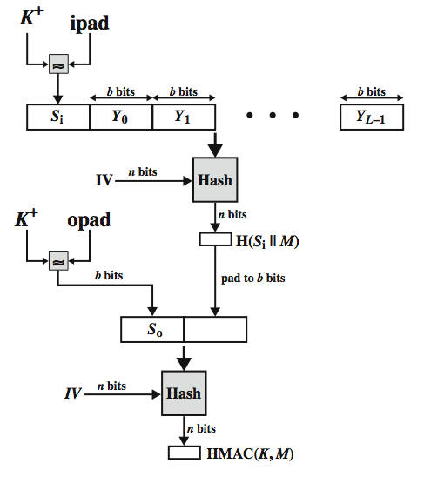
HMAC Overview
Notes:
29
Stallings Figure 12.5 illustrates the overall operation of HMAC:
HMAC_{K} = Hash[(K⁺ XOR opad) || Hash[(K⁺ XOR ipad) || M)]
where:
K⁺ is K padded with zeros on the left so that the result is b bits in length
ipad is a pad value of 36 hex repeated to fill block
opad is a pad value of 5C hex repeated to fill block
M is the message input to HMAC (including the padding specified in the embedded hash function)
Note that the XOR with ipad results in flipping one-half of the bits of K. Similarly, the XOR with opad results in flipping one-half of the bits of K, but a different set of bits. In effect, pseudorandomly generated two keys from K. HMAC should execute in approximately the same time as the embedded hash function for long messages. HMAC adds three executions of the hash compression function (for Si, So, and the block produced from the inner hash). A more efficient implementation is possible by precomputing the internal hash function on (K⁺ XOR opad) and (K⁺ XOR ipad) and inserting the results into the hash processing at start & end. With this implementation, only one additional instance of the compression function is added to the processing normally produced by the hash function. This is especially worthwhile if most of the messages for which a MAC is computed are short.

Slide 30
HMAC
The overall operation of HMAC:
HMAC_{K} = Hash[(K⁺ XOR opad) || Hash[(K⁺ XOR ipad) || M)]
where:
K⁺ is K padded with zeros on the left so that the result is b bits in length
ipad is a pad value of 36 hex repeated to fill block
opad is a pad value of 5C hex repeated to fill block
M is the message input to HMAC (including the padding specified in the embedded hash function)
Note that the XOR with ipad results in flipping one-half of the bits of K.
Similarly, the XOR with opad results in flipping one-half of the bits of K, but a different set of bits.
In effect, pseudorandomly generated two keys from K.
HMAC should execute in approximately the same time as the embedded hash function for long messages.
Notes:
30
The idea of a keyed hash evolved into HMAC, designed to overcome some problems with the original proposals. It involves hashing padded versions of the key concatenated with the message, and then with another outer hash of the result prepended by another padded variant of the key. The hash function need only be used on 3 more blocks than when hashing just the original message (for the two keys + inner hash). HMAC can use any desired hash function, and has been shown to have the same security as the underlying hash function. Can choose the hash function to use based on speed/security concerns.

Slide 31
HMAC Security
proved security of HMAC relates to that of the underlying hash algorithm
attacking HMAC requires either:
brute force attack on key used
birthday attack (but since keyed would need to observe a very large number of messages)
choose hash function used based on speed verses security constraints
Notes:
31
The appeal of HMAC is that its designers have been able to prove an exact relationship between the strength of the embedded hash function and the strength of HMAC. The security of a MAC function is generally expressed in terms of the probability of successful forgery with a given amount of time spent by the forger and a given number of message-MAC pairs created with the same key. Have two classes of attacks: brute force attack on key used which has work of order 2^n; or a birthday attack which requires work of order 2^(n/2) - but which requires the attacker to observe 2^n blocks of messages using the same key - very unlikely. For a hash code length of 128 bits, this requires 2⁶⁴ observed blocks (2⁷² bits) generated using the same key. On a 1-Gbps link, one would need to observe a continuous stream of messages with no change in key for about 150,000 years in order to succeed. So even MD5 is still secure for use in HMAC given these constraints.

Slide 32
Using Symmetric Ciphers for MACs
can use any block cipher chaining mode and use final block as a MAC
Data Authentication Algorithm (DAA) is a widely used MAC based on DES-CBC
using IV=0 and zero-pad of final block
encrypt message using DES in CBC mode
and send just the final block as the MAC
or the leftmost M bits (16≤M≤64) of final block
but final MAC is now too small for security…
… can use message blocks in reverse order…
Notes:
32
In this section, we look at two MACs that are based on the use of a block cipher mode of operation. We begin with an older algorithm, the Data Authentication Algorithm (DAA), a widely used though now obsolete MAC based on DES-CBC (next slide). However this suffers from being too small for acceptable use today.

Slide 33
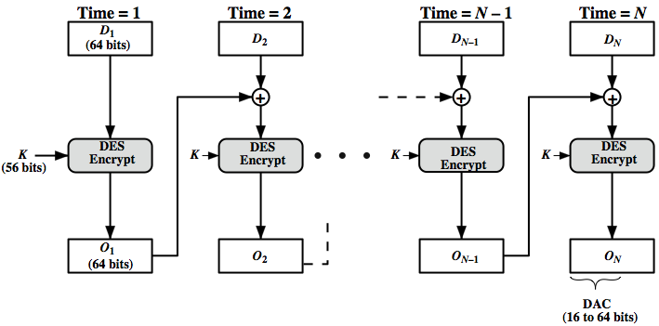
Data Authentication Algorithm
Notes:
33
The Data Authentication Algorithm, based on DES, has been one of the most widely used MACs for a number of years. The algorithm is both a FIPS publication (FIPS PUB 113) and an ANSI standard (X9.17). However, security weaknesses in this algorithm have been discovered and it is being replaced by newer and stronger algorithms. The algorithm is shown here in Stallings Figure 12.7, and can be defined as using the cipher block chaining (CBC) mode of operation of DES, with an initialization vector of zero, and 0-pad of the final block if needed. Resulting MAC can be 16-64 bits of the final block. But this is now too small for security.

Slide 34
Data Authentication Algorithm
The Data Authentication Algorithm, based on DES, has been one of the most widely used MACs for a number of years.
The algorithm is both a FIPS publication (FIPS PUB 113) and an ANSI standard (X9.17).
However, security weaknesses in this algorithm have been discovered and it is being replaced by newer and stronger algorithms.
The algorithm is shown here in Stallings Figure 12.7, and can be defined as using the cipher block chaining (CBC) mode of operation of DES, with an initialization vector of zero, and 0-pad of the final block if needed.
Resulting MAC can be 16-64 bits of the final block.
But, this is now too small for security.
Notes:
34
In this section, we look at two MACs that are based on the use of a block cipher mode of operation. We begin with an older algorithm, the Data Authentication Algorithm (DAA), a widely used though now obsolete MAC based on DES-CBC (next slide). However this suffers from being too small for acceptable use today.

Slide 35
Agenda
Introduction
Message authentication requirements
Message authentication using encryption
MACs
HMAC authentication using a hash function
CMAC authentication using a block cipher
Summary
Test your understanding
References

Slide 36
CMAC
previously saw the DAA (CBC-MAC)
widely used in govt & industry
but has message size limitation
can overcome using 2 keys & padding
thus forming the Cipher-based Message Authentication Code (CMAC)
adopted by NIST SP800-38B
Notes:
36
The Data Authentication Algorithm cipher-based MAC has been widely adopted in government and industry. Has been shown to be secure, with the following restriction. Only messages of one fixed length of mn bits are processed, where n is the cipher block size and m is a fixed positive integer. This limitation can be overcome using multiple keys, which can be derived from a single key. This refinement has been adopted by NIST as the cipher-based message authentication code (CMAC) mode of operation, for use with AES and triple DES. It is specified in NIST Special Publication 800-38B.

Slide 37
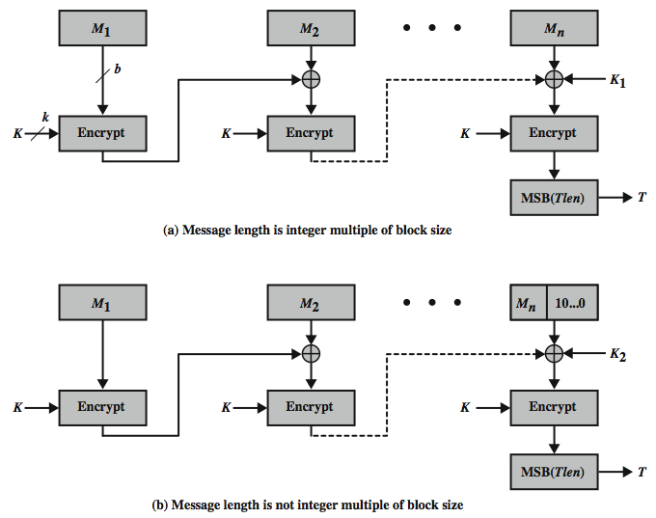
CMAC Overview
Notes:
37
Stallings Figure 12.8 shows the structure of CMAC. It uses the blocksize of the underlying cipher (ie 128-bits for AES or 64-bits for triple-DES). The message is divided into n blocks M1..Mn, padded if necessary. The algorithm makes use of a k-bit encryption key K and an n-bit constant K1 or K2 (depending on whether the message was padded or not). For AES, the key size k is 128,192, or 256 bits; for triple DES, the key size is 112 or 168 bits. The two constants K1 & K2 are derived from the original key K using encryption of 0 and multiplication in GF(2^n), as detailed in the text.

Slide 38
CMAC
It uses the blocksize of the underlying cipher (ie 128-bits for AES or 64-bits for triple-DES).
The message is divided into n blocks M1..Mn, padded if necessary.
The algorithm makes use of a k-bit encryption key K and an n-bit constant K1 or K2 (depending on whether the message was padded or not).
For AES, the key size k is 128,192, or 256 bits; for triple DES, the key size is 112 or 168 bits.
The two constants K1 & K2 are derived from the original key K using encryption of 0 and multiplication in GF(2^n)
Notes:
38
The Data Authentication Algorithm cipher-based MAC has been widely adopted in government and industry. Has been shown to be secure, with the following restriction. Only messages of one fixed length of mn bits are processed, where n is the cipher block size and m is a fixed positive integer. This limitation can be overcome using multiple keys, which can be derived from a single key. This refinement has been adopted by NIST as the cipher-based message authentication code (CMAC) mode of operation, for use with AES and triple DES. It is specified in NIST Special Publication 800-38B.

Slide 39
Agenda
Introduction
Message authentication requirements
Message authentication using encryption
MACs
HMAC authentication using a hash function
CMAC authentication using a block cipher
Summary
Test your understanding
References

Slide 40
Summary
have considered:
message authentication requirements
message authentication using encryption
MACs
HMAC authentication using a hash function
CMAC authentication using a block cipher
Notes:
40
Chapter 12 summary.

Slide 41
Agenda
Introduction
Message authentication requirements
Message authentication using encryption
MACs
HMAC authentication using a hash function
CMAC authentication using a block cipher
Summary
Test your understanding
References

Slide 42
Test your understanding
What are the requirement of MAC?
Explain HMAC.
Explain CMAC.

Slide 43
Agenda
Introduction
Message authentication requirements
Message authentication using encryption
MACs
HMAC authentication using a hash function
CMAC authentication using a block cipher
Summary
Test your understanding
References

Slide 44
References
1. William Stallings, Cryptography and Network Security, 6th Edition, Pearson Education, March 2013.
2. Charlie Kaufman, Radia Perlman and Mike Speciner, “Network Security”, Prentice Hall of India, 2002.

